Slide 1
Our Parliament:
The People’s Majlis
Key Stage 1 & 2

Slide 2
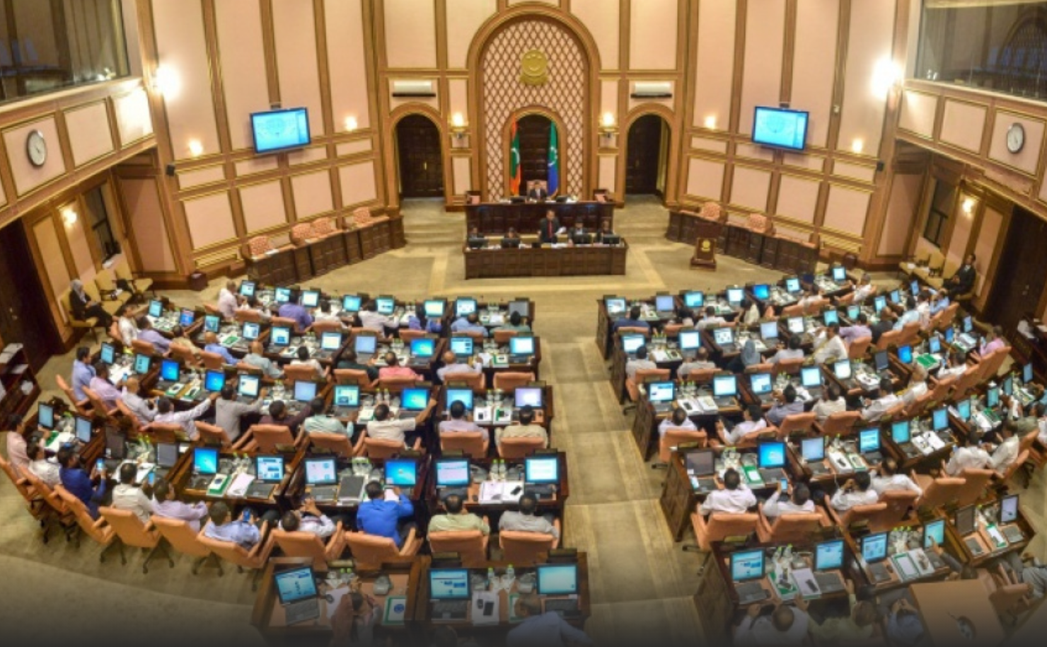

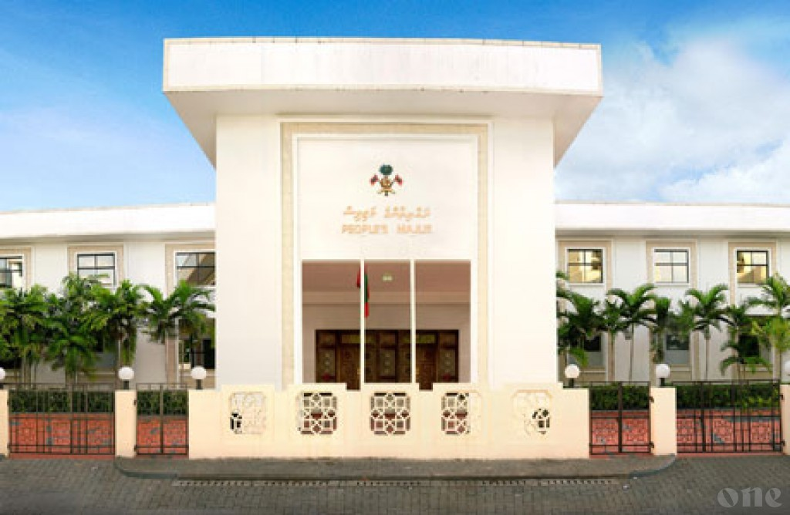

The
People’s Majlis
Who works here?
Who is the Head?
What do they do here?

Slide 3
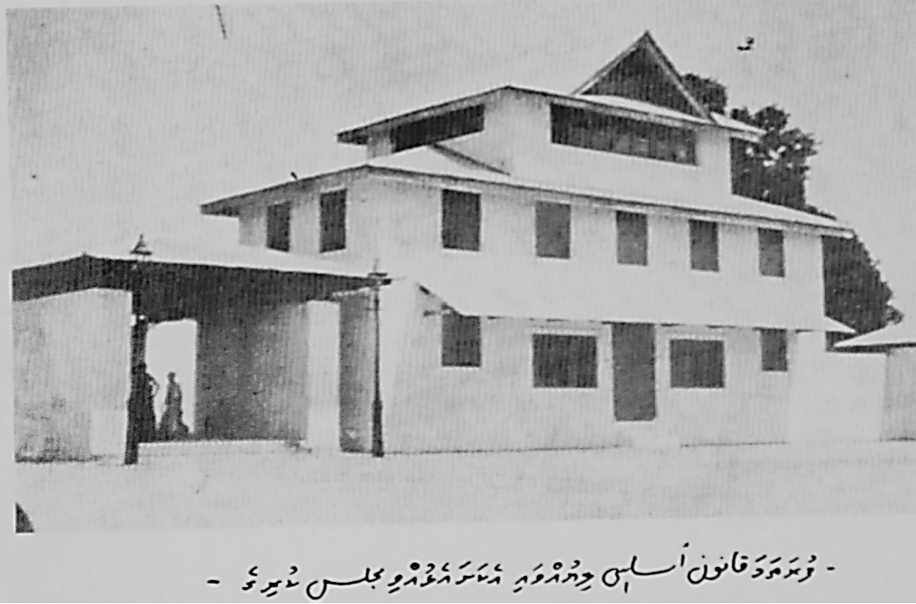
A brief history…
1932 - The first Constitution of Maldives ratified. First parliament was also created.
1953 - Changed from Monarchy to a Republic after a public referendum. (Government switched back to a Monarchy soon)
1965 - Independence from Britain
1968 - Referendum voted and Second Republic formed
2004 - Political reforms began
  2008 - Constitution ratified on 7 August 2008
  2009 – Majlis sworn in with MPs representing different Political Parties.

Slide 4

Majlis Logo
3 stars = the 3 Powers of State
Crescent = the Islamic faith of the nation
The Arabic words = Majlis motto
“…and whose affairs are a matter of Counsel (make decisions by Consultation)
Quranic verse 42:38

Slide 5

Majlis Flag
Green = the islands and the physical structure of the country
Blue = the sea which constitutes 99% of the Country
Crescent = the Islamic faith of the nation
3 stars = the 3 powers of the State

Slide 6
Who works at the Majlis?
Speaker
Members of Parliament
Committee Members
Deputy Speaker
How do they work?
Notes:
Majlis members have meetings called ‘sittings’, where all the MPs debate and discuss important topics put forward to the Majlis. Majlis members also work in specific Committees, where they investigate matters in detail before they make decisions

Slide 7
Majlis Chamber

Slide 8
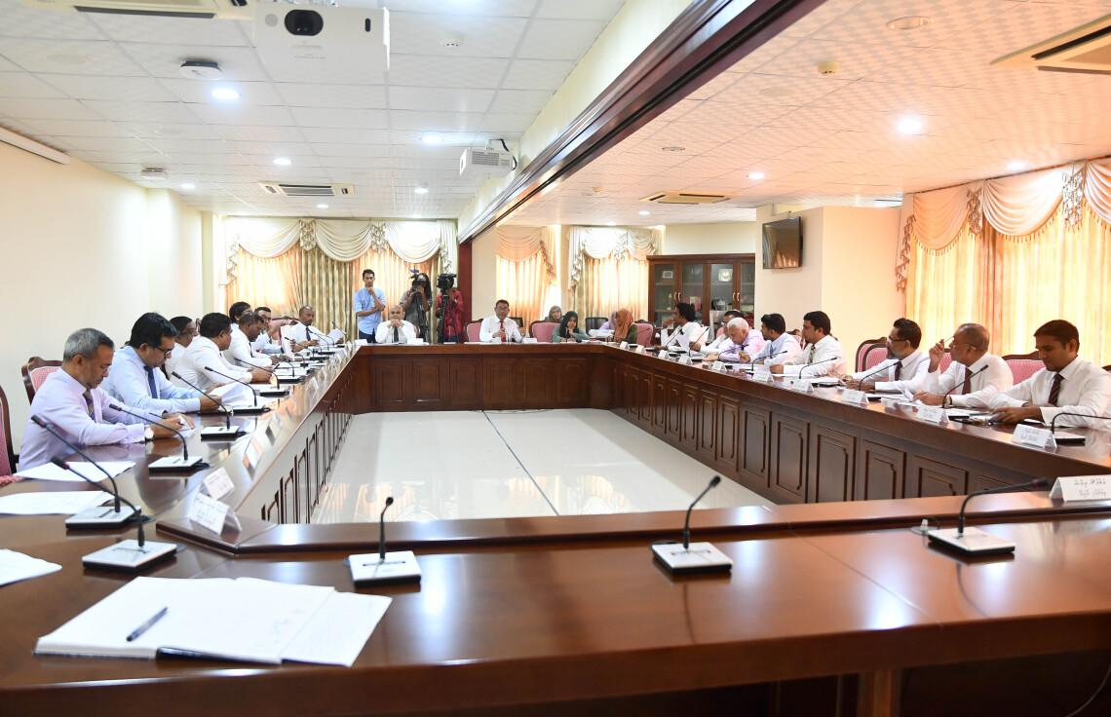
Committee Rooms

Slide 9

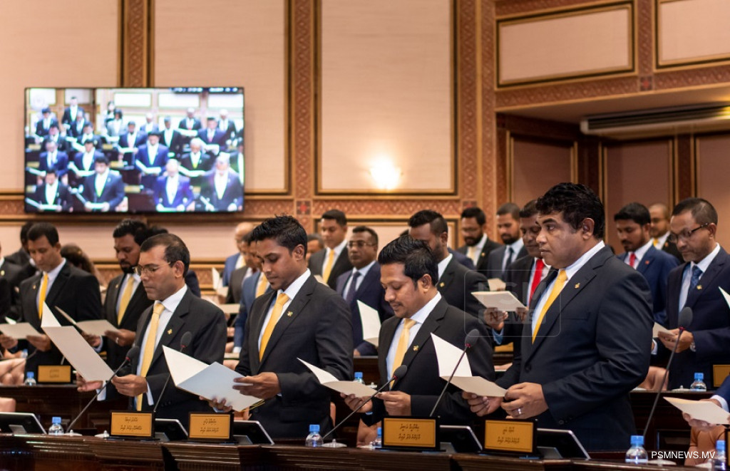
How are MPs elected?
Elected for a 5-year term
Represents a specific area called Constituency or Dhaairaa
Elected by people through
voting

Slide 10
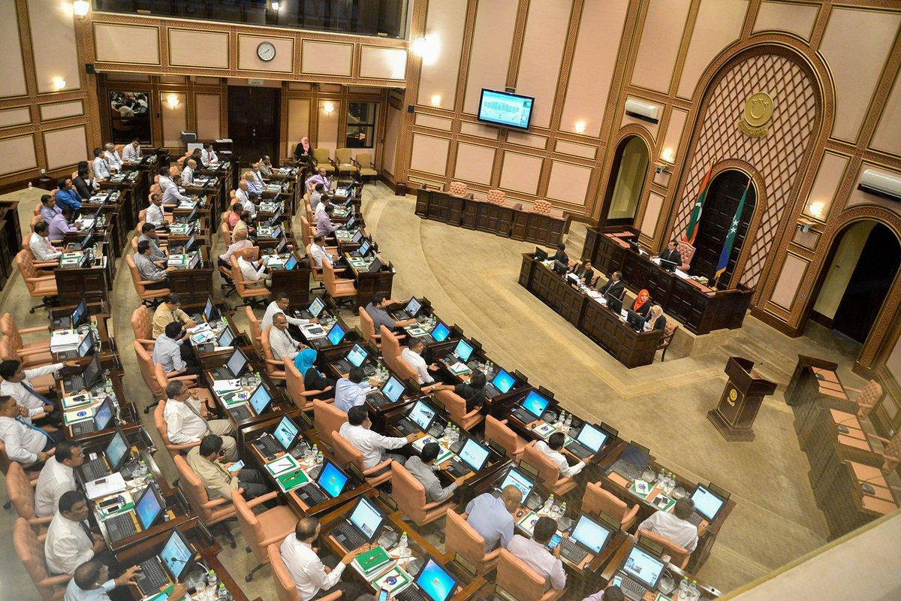
Functions of the Majlis:
What do they do at the Majlis?
01
02
03
Represent the citizens
Make Laws
Oversee the government

Slide 11


Process of making a Law
Bill
Law
Sponsor of the Bill proposes the Bill
Bill introduced to Majlis
Debate & Vote to accept Bill.
Then Sent to Committee for review and reporting back to floor
Discuss More, suggest changes, Vote to accept Law
Agree OR suggest changes OR send back to Majlis
Once president agrees, ratify and published in Gazette as a Law
Drafting
1st Reading
2nd Reading
3rd Reading
Presidential Assent
Publishing

